Slide 1

Budget Text Analysis
- Datatopian Visionaries
Akash Meghani,
Miguel Gaspar Utrera,
Naseeb Thapaliya,
Sultan Al Bogami,
Unnati Khivasara
Mentors: Dr. Soumya Mohanty
Jason Jones (Guilford County)

Slide 2
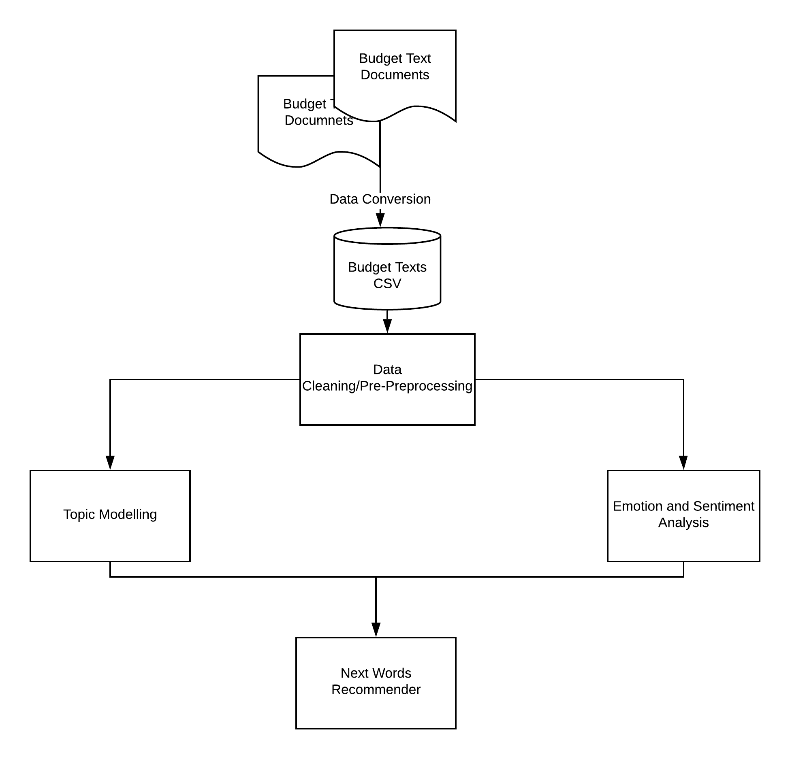
Overview of the Project

Slide 3
Goals (Questions Formulated)
What are the properties of the budget text data ?
Are there any intrusive structures and patterns in the budget texts from all the counties ?
Does the topics change over the years (2008, 2029) ?
Does different sections of budget text data have any common relation between them ?
Does general funds section of Guilford county, Durham County and Charlotte City give similar sentiments or they are different ?
How can we visualize the topics and emotions between 2008 and 2019 with proper analytics ?
Does a topic model for one year can identify the latent semantic structure that persists over time in this budget text domain ?
Can we formulate a next word recommender from our analysis ?

Slide 4
Tasks Assigned based on Objectives
Sultan Al Bogami 1. Collected Budget Documents from all the different Counties websites and other sources(2008 to 2020) and organization of github. 2. Converted the pdf documents to ccv formats. Extract words from the documents using online tool, and Perform data processing. 3. Perform Statistical analysis and corpus similarity of budget texts.
Naseeb Thapaliya 1. Compared the topic modeling results over the years (2008,2020) 2. Perform Supervised Machine Learning on topics from topics Modeling.
Miguel Gasper Utrera 1. Applied Topic modeling on different relevant topics from all the counties and computed their coherence score with proper visualization.
2. Applied Davis model and showed top 30 words in each topic and their relevence.
Unnati Khivasera 1. Analyzing sentiment intensity using Vader.
2. Performed visualization of emotions from different sections of documents.
Akash Meghani 1. Applied Emotional and Sentiment analysis with NLTK and got meaningful results. 2. Performed visualization of emotions from different sections of documents.
Everyone 1. Documentation of project and maintain and work on GitHub. 2. Work on Nextword recommender

Slide 5
Data Overview
Primarily, 7 pdf files ranging from 400-500 pages long for each.
Each pdf is converted to csv files by extracting all the relevant budget texts(words) from the pdf file.
So, there are total of 638131 total words extracted from the budget files.

Slide 6
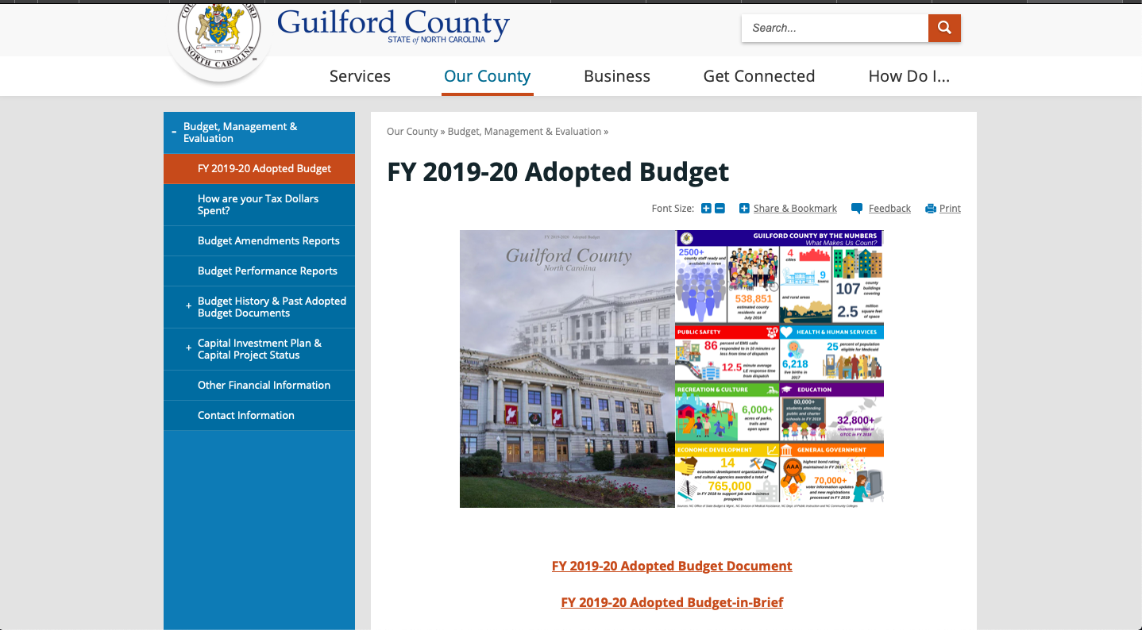
Data Source

Slide 7
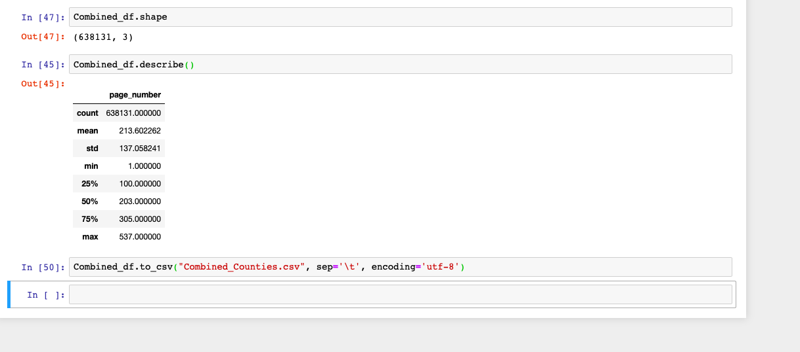
Data Analysis

Slide 8
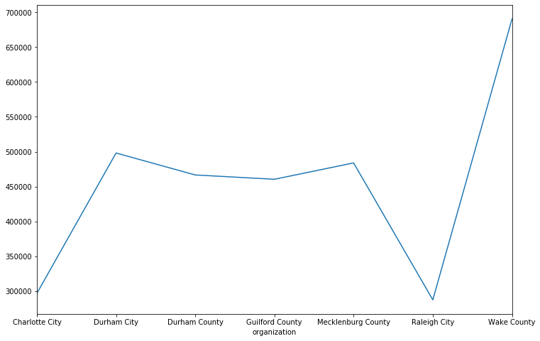
Count of words grouped by
organizations.

Slide 9
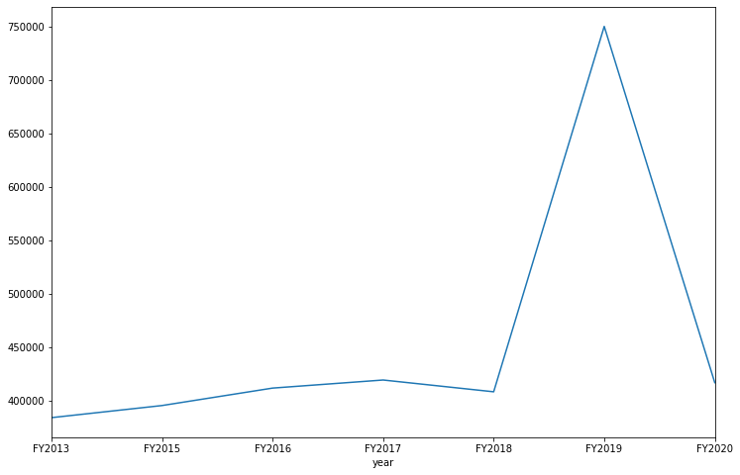
Count of words grouped by
year.

Slide 10
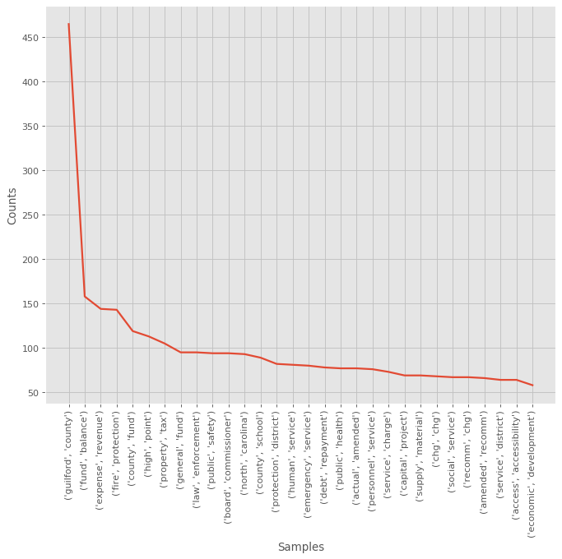
Most Frequent bigrams in
Guilford County budget document
From 2020

Slide 11
Corpus Similarity
Goal: Quantify the similarities between the budget documents.
Method: cosine similarity is selected to determine the similarity between the documents irrespective.
Why?
Other common methods find the similarities by counting the maximum number of common words between the documents.
Cosine: does not take size of the documents into account.

Slide 12
Corpus Similarity
The steps followed to achieve the our goal are:
1. Define the documents,
2. Vectorize,
3. Compute cosine similarity,
4. Visualize the results.

Slide 13
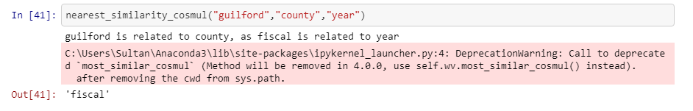
Linear relationship between words

Slide 14
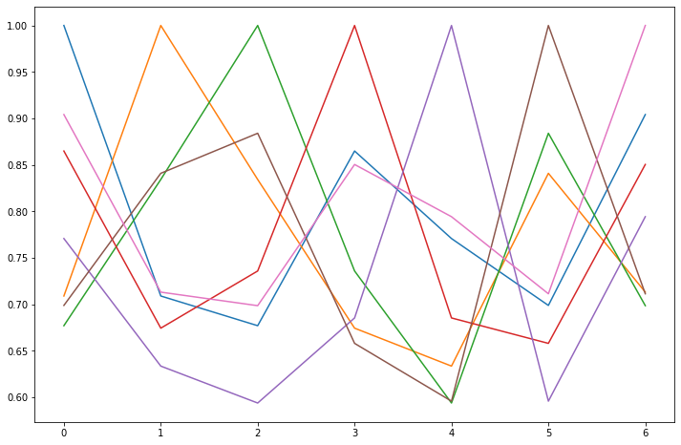
Results – Data from 2020-2013
#1- Guilford County
#2- Charlotte City
#3- Durham City
#4- Durham County
#5 -Mecklenburg County
#6- Raleigh City
#7- Wake County

Slide 15

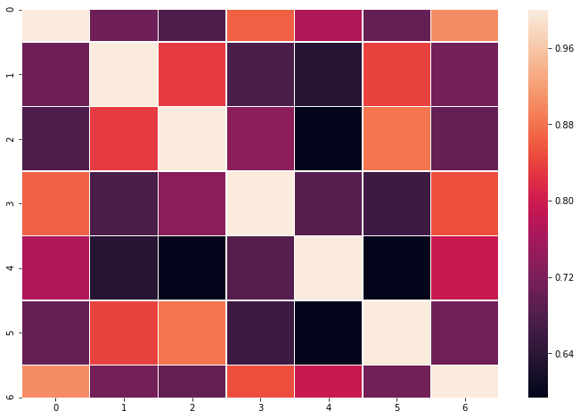
Results
#1- Guilford County
#2- Charlotte City
#3- Durham City
#4- Durham County
#5 -Mecklenburg County
#6- Raleigh City
#7- Wake County

Slide 16
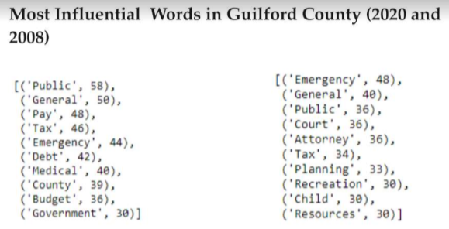
Sentiment Analysis : Influential words

Slide 17
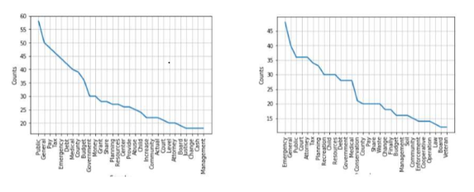
Frequency of most influential words(2020 and 2008)

Slide 18
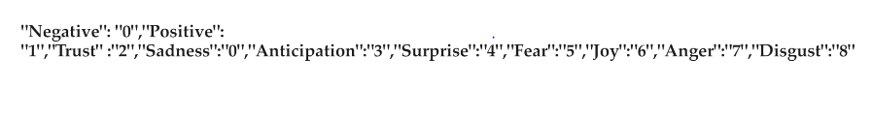
Sentiment Analysis : Sentiment renaming

Slide 19
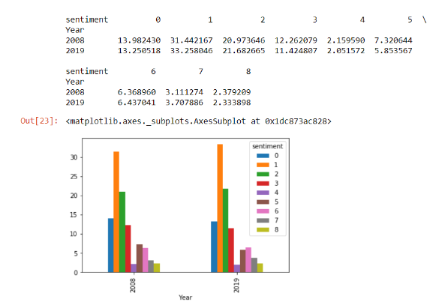
Distribution of Emotions Services section for Guilford County
Distribution of Emotions Services section for Guilford County

Slide 20

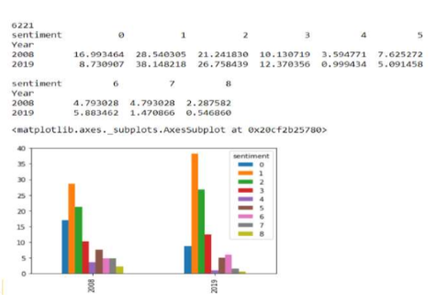



Distribution of Emotions in General Fund section (2008 and 2020) for Charlotte County

Slide 21
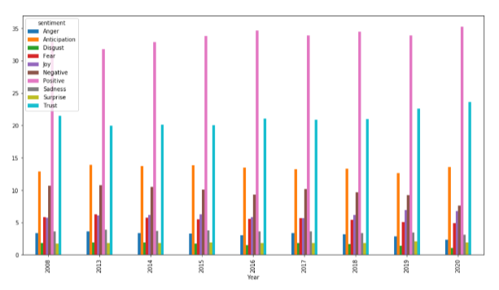
Charlotte sentiments and emotions distribution over the years(2008 and 2013 to 2020):

Slide 22
Charlotte Sentiment Continue..
The plot shows that Positive sentiments increased after 2008 till year 2016 and slightly dropped in 2017 and remained stable in further years.
While the Negative sentiments have reverse impact, as they dropped till year 2016 and increased in 2017 and then again dropped till 2020.
Also the emotions like Disgust and Fear kept reducing over the years while Anticipation remained almost same for all years.

Slide 23
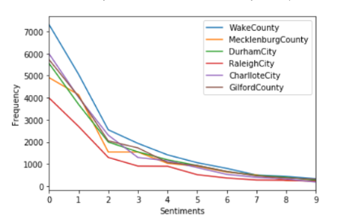
sentiments and emotions for all the cities
Frequency Distribution of sentiment and emotions in the budget document remains the same.
In Mecklenburg county it is noticed that the negative sentiment is slightly increased while this is not seen for all the cities.

Slide 24
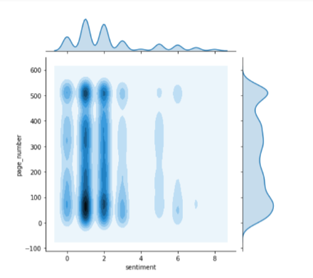
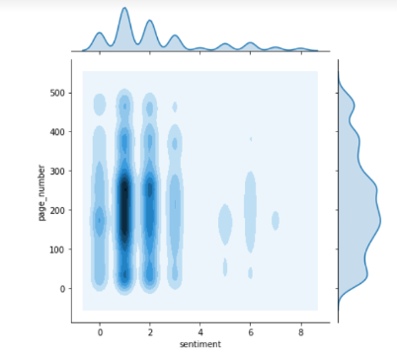
Sentiment and emotion distribution with respect to page number

Slide 25
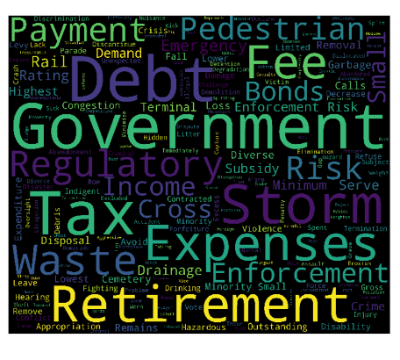
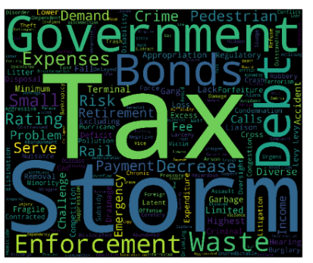
Charlotte city negative words (2008 and 2020)

Slide 26
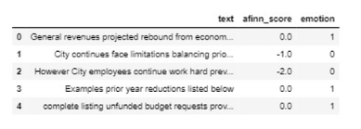
Machine Learning
Sample data

Slide 27
Machine learning
Split the data in 70/30 for creating train/test dataset.
TF-IDF was used on training data. This vectorizer breaks text into single words and bi grams and create TF-IDF representation to create feature vectors.
X -> Vectorized text
Y-> (positive, negative)

Slide 28
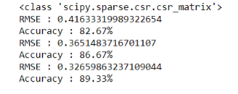
Machine Learning
Results

Slide 29
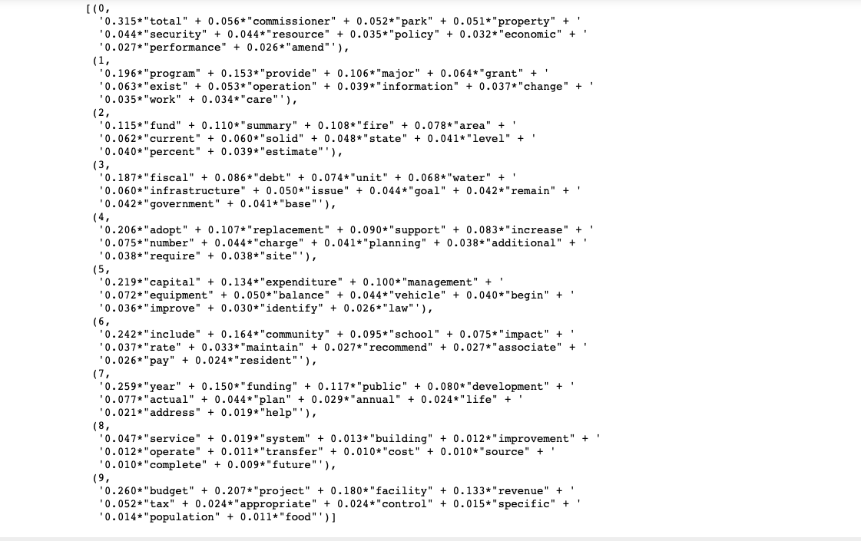
Topic Modeling

Slide 30
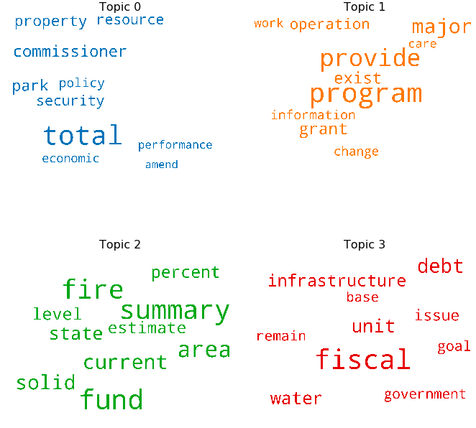
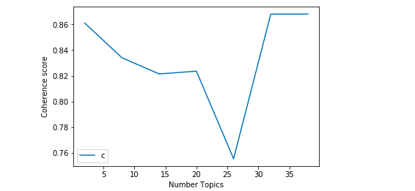
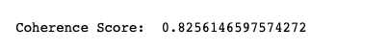
Topic Modeling
Label: Property Maintenance and Security
Label: Grant for Work or Program
Label: State Fire Fund
Label: Government Fiscal Year

Slide 31
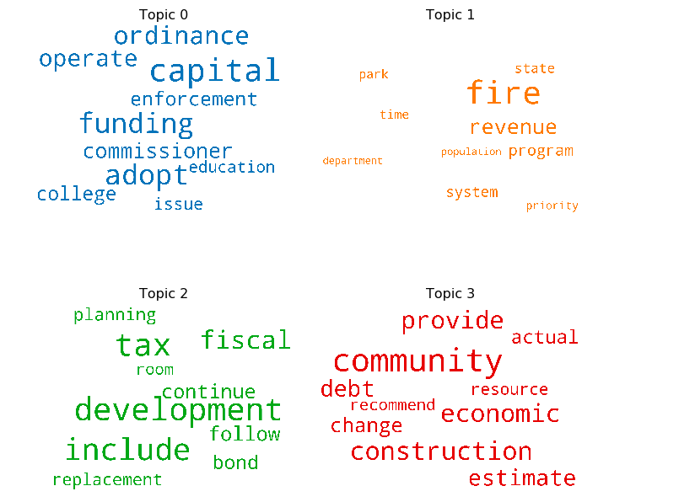
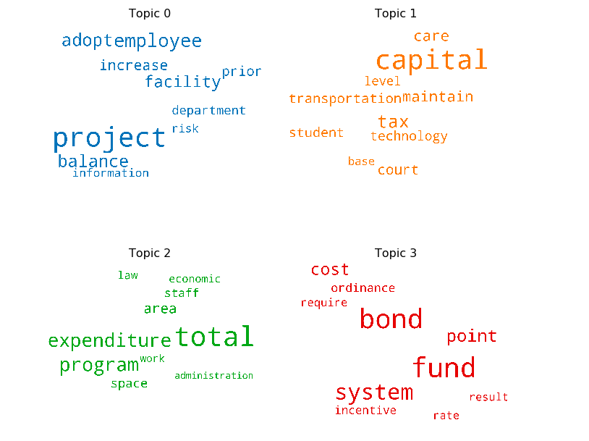
Topic Modeling Comparison
Label: Capital Funding for Education
Label: Fire Fund Program
Label: Student Tax
Label: Increase risk in project, department
Label: Fiscal Year Planning
Label: Community Construction
Label: Economic Expenditure
Label: Financial Indicators
2019
2008

Slide 32
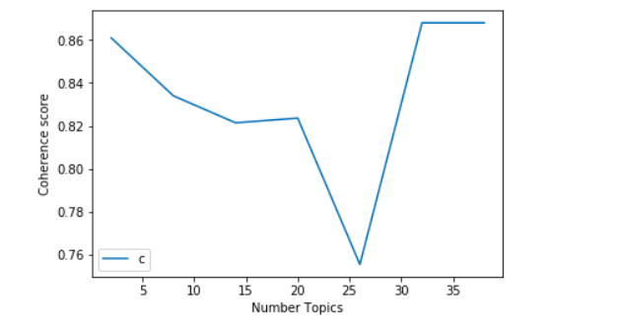
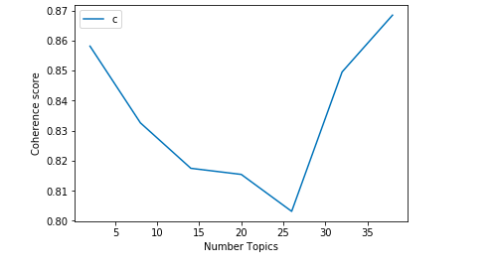


Topic Modeling Comparison
2019
2008

Slide 33
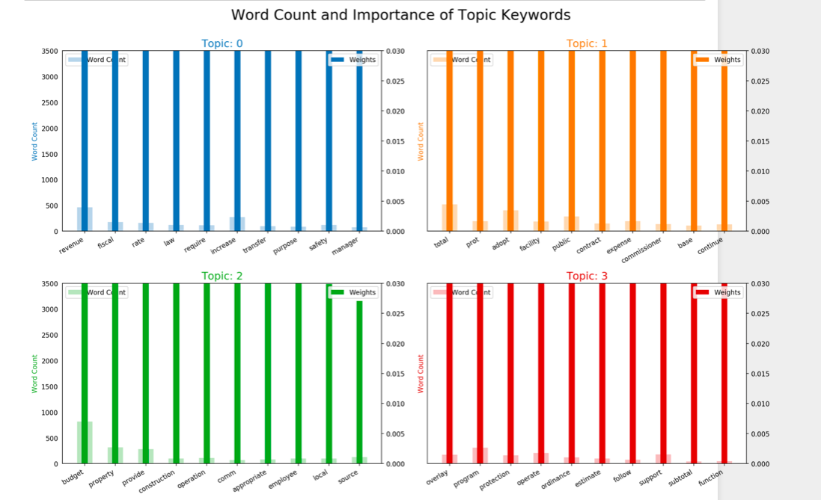
Topic Modeling

Slide 34
Machine Learning Tasks
Train LDA Model on the budget texts from 2019.
Grab Topic distributions for every budget texts using the LDA Model
Use Topic Distributions directly as feature vectors in supervised classification models (Logistic Regression, SVM, etc) and get F1-score.
Use the same 2019 LDA model to get topic distributions from 2018 and 2020 (the LDA model did not see this data!)
Run supervised classification models again on the 2018 and 2020 vectors and see if this generalizes.

Slide 35
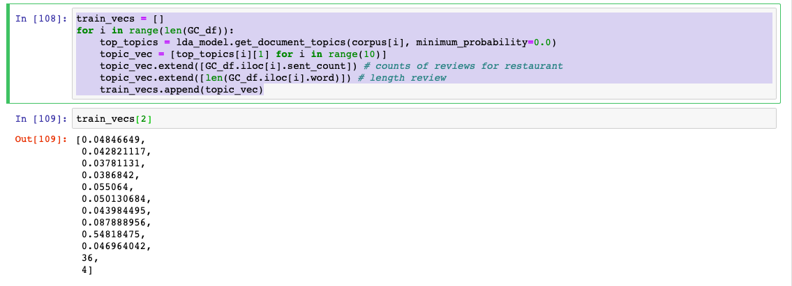
Converting Topics to Feature Vectors for Machine Learning

Slide 36
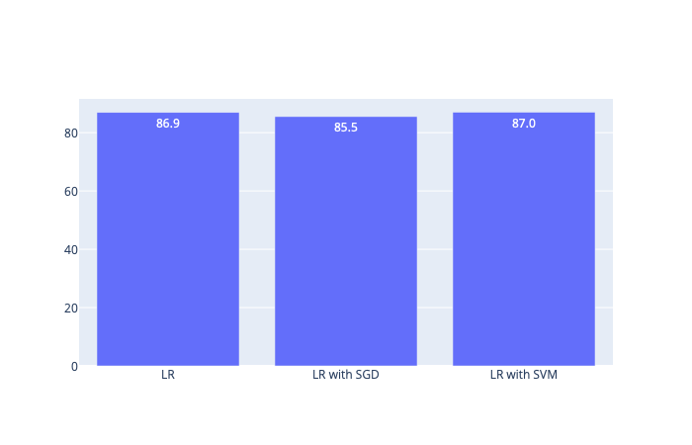
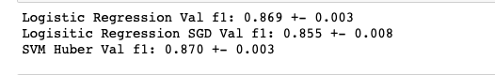
Supervised Classification (Training Data Result)
X = [train_vecs];
Y = [predicted_labels];
Result:

Slide 37
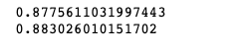
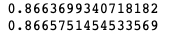
Supervised Classification (Testing on Unseen Data
For 2018:
For 2020:

Slide 38
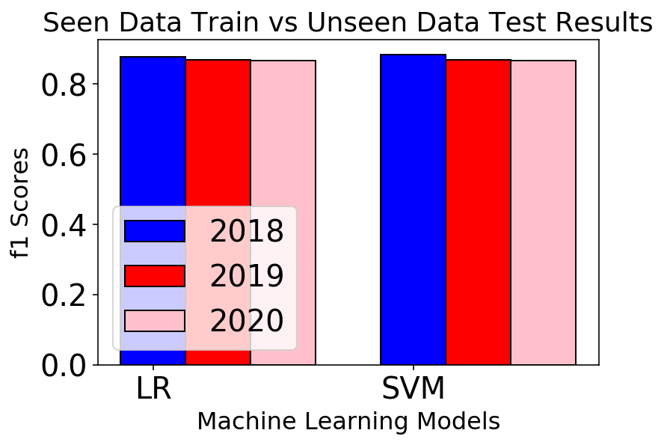
Supervised Classification (On Test Data)
SHOCKING!!!!!!!

Slide 39

Hypothesis Testing
H0(null hypothesis) -> The ML models are similar and perform for all the year .
H1 -> The ML models are truly different and perform differently.
Condition for Hypothesis taken such that p-value threshold is p = 0.05
Hence, the null hypothesis was rejected, as the models were completely different.

Slide 40
Next Word Recommender
Simulated text with markov chain method.
A Markov chain is a simulated sequence of events. Each event in the sequence comes from a set of outcomes that depend on one another.
For any sequence of non-independent events in the world, and where a limited number of outcomes can occur, conditional probabilities can be computed relating each outcome to one another.
To generate a simulation based on a certain text, count up every word that is used. Then, for every word, store the words that are used next. This is the distribution of words in that text conditional on the preceding word.

Slide 41
Next Word Recommender
https://drive.google.com/open?id=1J-O3GMuii8fL9DrOM0MvREFdU9eznQYk

Slide 42
Conclusion
The topic modeling analysis implicates the topic model for 2019 year can identify the latent semantic structure that persists over time in this budget text domain
Comparison between topic models showed that frequent topics between 2008 and 2016 are dissimilar to each other.
Altogether mostly all the cities and counties considered showed much similarity in the type of sentiments, which was passed over the years.
Even though, the topics were quite different, the sentiments were similar over the years.
Next word recommender recommends a next words from a cluster based on the previous words.

